Slide 1
UNIT-II-Divide and Conquer
Graph problems: BFS
DFS
Articulation point
Stable and Unstable algorithms
Material prepared by Dr. N. Subhash Chandra
From Web resources, Computer Algorithms , Horowitz, Sahni & Rajasekaran

Slide 2
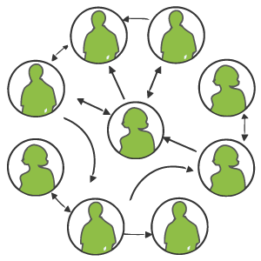
Graph Applications
Traversing the graph means examining all the nodes and vertices of the graph. There are two standard methods
Breadth First Search
Depth First Search
Applications: Articulation point, Topological Sort, Convex hull
Web pages with links
Road maps (e.g., Google maps)
Airline routes
Facebook friends
Family trees
Paths through a maze

Slide 3
Paths
path: A path from vertex a to b is a sequence of edges that can be followed starting from a to reach b.
can be represented as vertices visited, or edges taken
example, one path from V to Z: {b, h} or {V, X, Z}
What are two paths from U to Y?
path length: Number of vertices or edges contained in the path.
neighbor or adjacent: Two vertices connected directly by an edge.
example: V and X
V
a
b
U
d
X
Z
h
c
e
W
g
f
Y

Slide 4
Reachability, connectedness
reachable: Vertex a is reachable from b if a path exists from a to b.
connected: A graph is connected if every vertex is reachable from any other.
Is the graph at top right connected?
strongly connected: When every vertex has an edge to every other vertex.
V
a
b
U
d
X
Z
h
c
e
W
g
f
Y
a
b
a
b
d
c
e
c
d

Slide 5
Loops and cycles
cycle: A path that begins and ends at the same node.
example: {b, g, f, c, a} or {V, X, Y, W, U, V}.
example: {c, d, a} or {U, W, V, U}.
acyclic graph: One that does not contain any cycles.
loop: An edge directly from a node to itself.
Many graphs don't allow loops.
V
a
b
U
d
X
Z
h
c
e
W
g
f
Y

Slide 6
Weighted graphs
weight: Cost associated with a given edge.
Some graphs have weighted edges, and some are unweighted.
Edges in an unweighted graph can be thought of as having equal weight (e.g. all 0, or all 1, etc.)
Most graphs do not allow negative weights.
example: graph of airline flights, weighted by miles between cities:
849
Chennai
1843
Colcatta
Lacknow
142
802
Hyd
1743
337
1387
Delhi
2555
1099
Patna
1233
Bhuv
1120
Mumb

Slide 7
Directed graphs
directed graph ("digraph"): One where edges are one-way connections between vertices.
If graph is directed, a vertex has a separate in/out degree.
A digraph can be weighted or unweighted.
Is the graph below connected? Why or why not?
a
b
c
d
e
f
g

Slide 8
Digraph example
Vertices = UW CSE courses (incomplete list)
Edge (a, b) = a is a prerequisite for b
120
131
142
140
450
143
154
331
311
341
351
373
374
332
403
312
344
333
352
410
413
414
431
446
444
421
440
451
415
417
452

Slide 9
Linked Lists, Trees, Graphs
A binary tree is a graph with some restrictions:
The tree is an unweighted, directed, acyclic graph (DAG).
Each node's in-degree is at most 1, and out-degree is at most 2.
There is exactly one path from the root to every node.
A linked list is also a graph:
Unweighted DAG.
In/out degree of at most 1 for all nodes.
F
B
K
A
B
C
D
A
E
H
G
J

Slide 10
Searching for paths
Searching for a path from one vertex to another:
Sometimes, we just want any path (or want to know there is a path).
Sometimes, we want to minimize path length (# of edges).
Sometimes, we want to minimize path cost (sum of edge weights).
What is the shortest path from MIA to SFO? Which path has the minimum cost?
$50
PVD
$70
ORD
SFO
$200
$130
$170
$80
LGA
$60
$140
HNL
$250
LAX
$120
$100
DFW
$110
MIA
$500

Slide 11
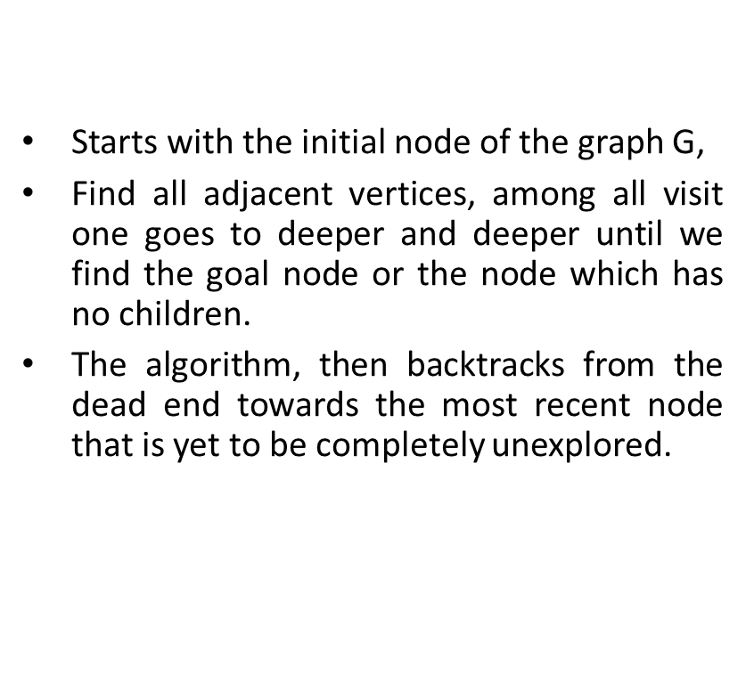
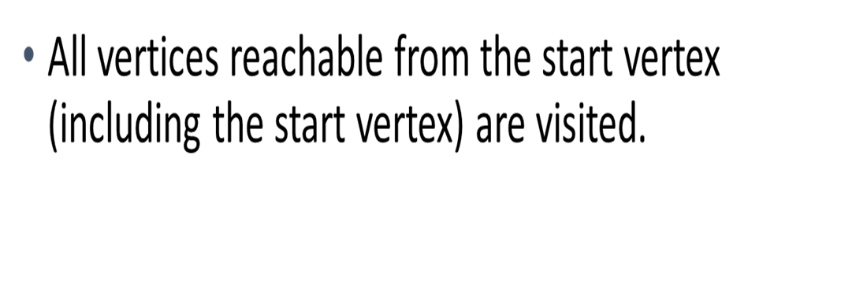
Algorithms Breadth First Search Depth First Search
Visit start vertex and put into a FIFO queue.
Repeatedly remove a vertex from the queue, visit its unvisited adjacent vertices, put newly visited vertices into the queue.

Slide 12
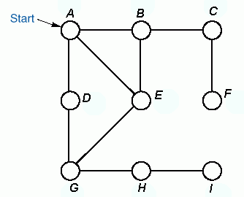

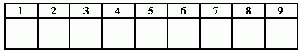
Example
Breadth-first traversal using a queue.
Queue front
BFS-tree:
Order of
Traversal
A B D E C G F H I
Queue rear
Note: The BFS-tree for undirected graph is a free tree

Slide 13
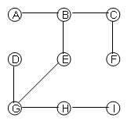
Example
Depth-first traversal using an explicit stack.
The Preorder Depth First Tree:
Order of
Traversal
A B C F E G D H I
Stack
Note: The DFS-tree for undirected graph is a free tree

Slide 14
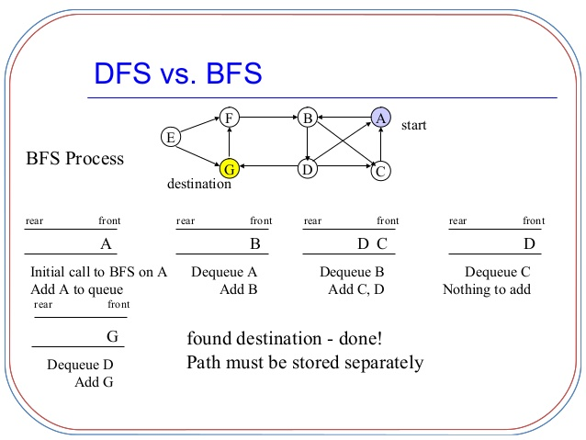
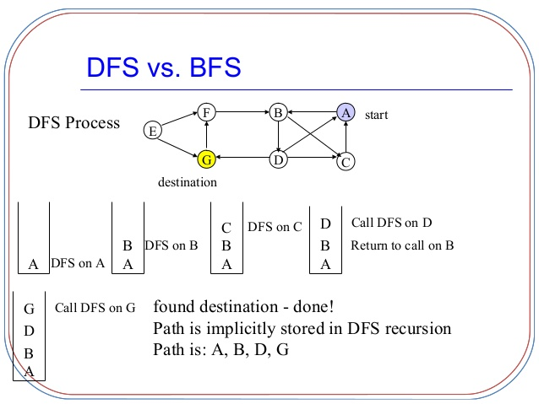
Example to search G using DFS, BFS

Slide 15
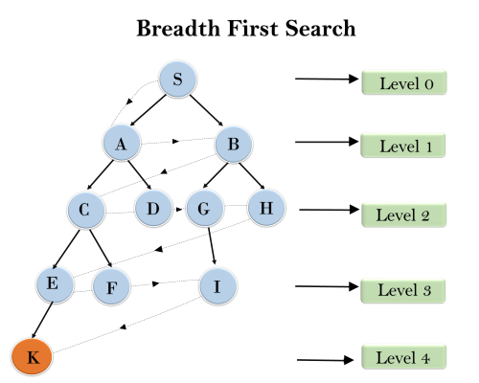
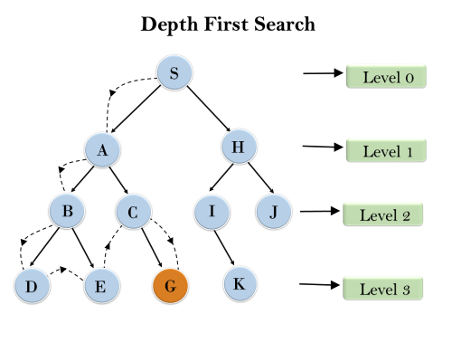
Searching in BFS, DFS

Slide 16
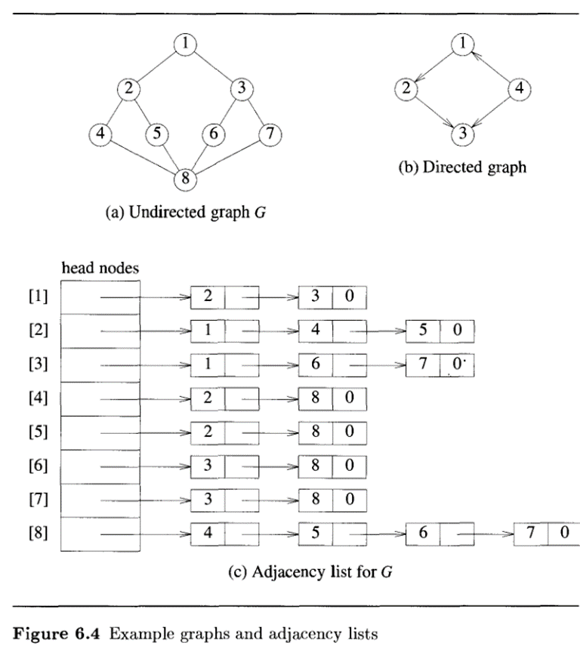
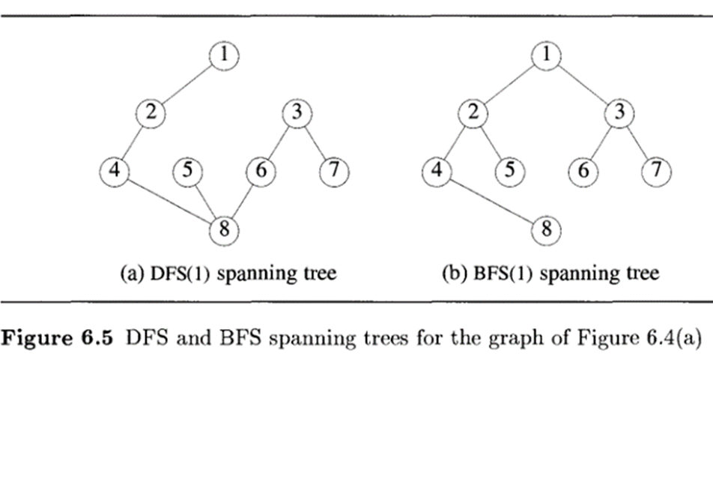
BFS, DFS Example

Slide 17
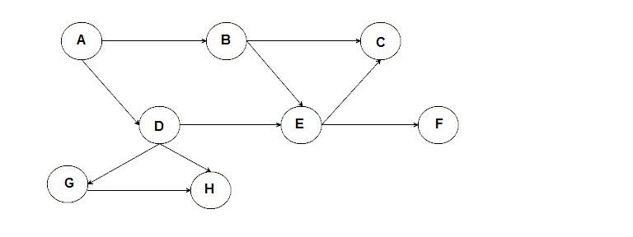
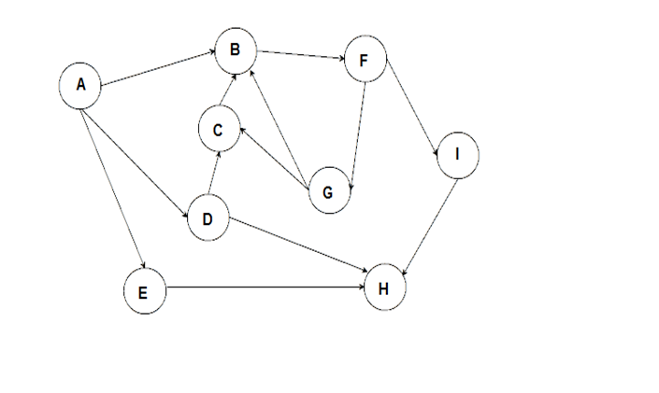
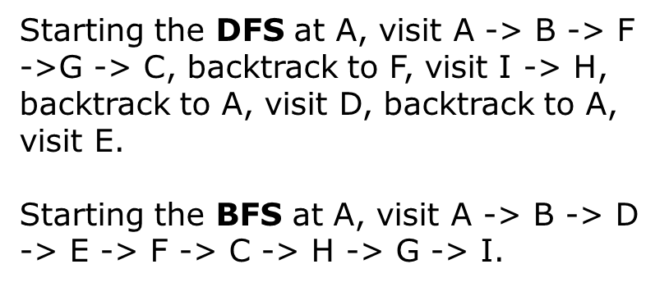
DFS, BFS Example
Starting the DFS at A, visit A -> B -> C, backtrack to B, visit E -> F, backtrack to A, visit D -> G -> H.
Starting the BFS at A, visit A -> B -> D -> C -> E -> G -> H -> F.

Slide 18
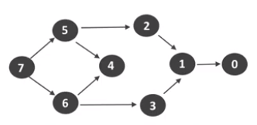
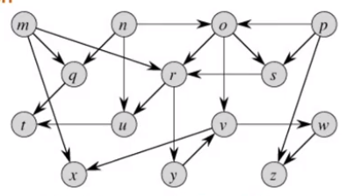
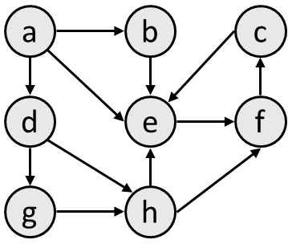
Exercise problems: Traverse by BFS,DFS

Slide 19
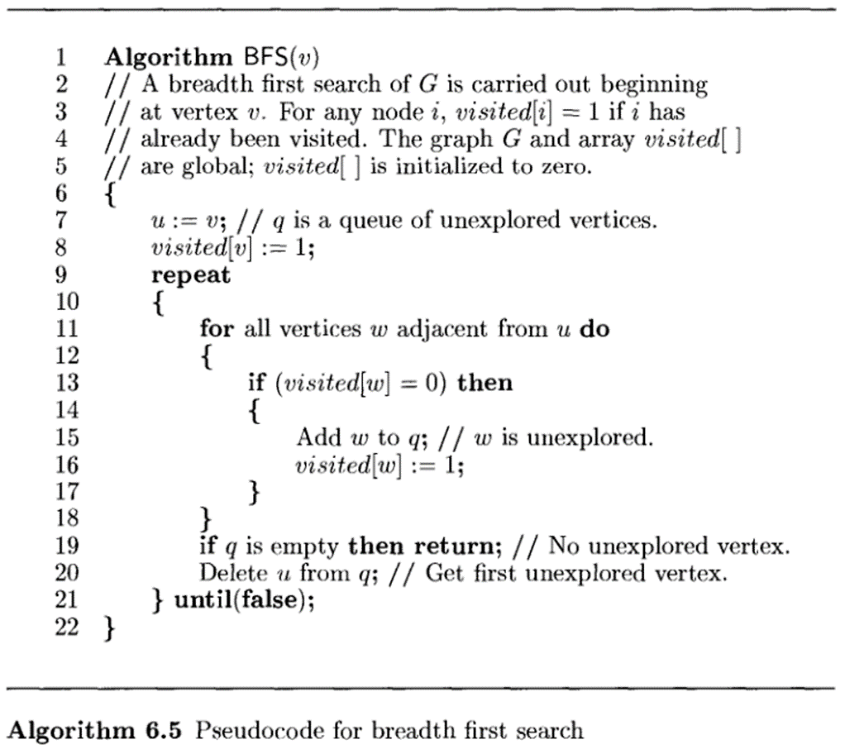
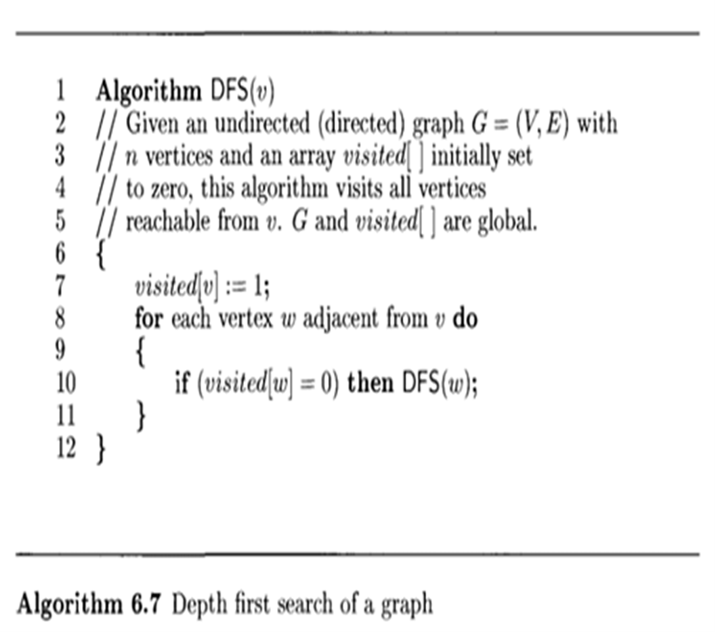
BFS,DFS Algorithms

Slide 20
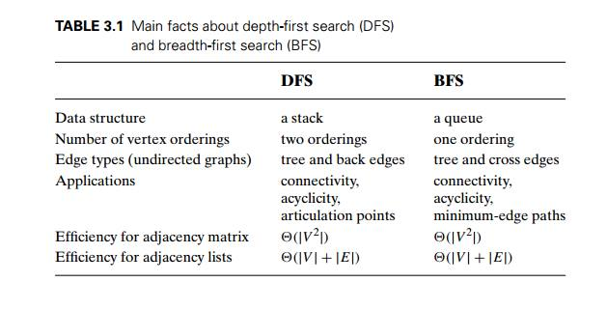
Difference b/w DFS, BFS
Complexities: When a vertex is removed from the queue, we examine its adjacent vertices.
O(n) if adjacency matrix used
O(vertex degree) if adjacency lists used
Total time
O(mn), where m is number of vertices in the component that is searched (adjacency matrix) = O(V²)
Adjacency list =O(V+E)

Slide 21
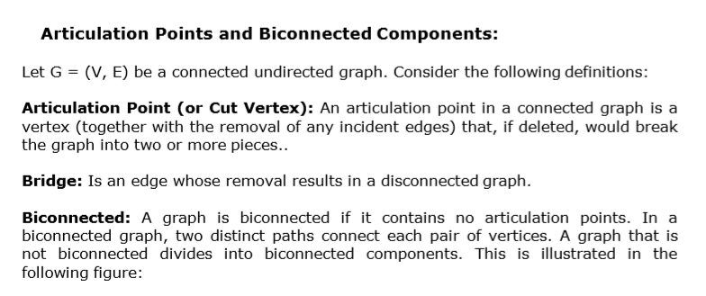
Application of DFS: Articulation point

Slide 22
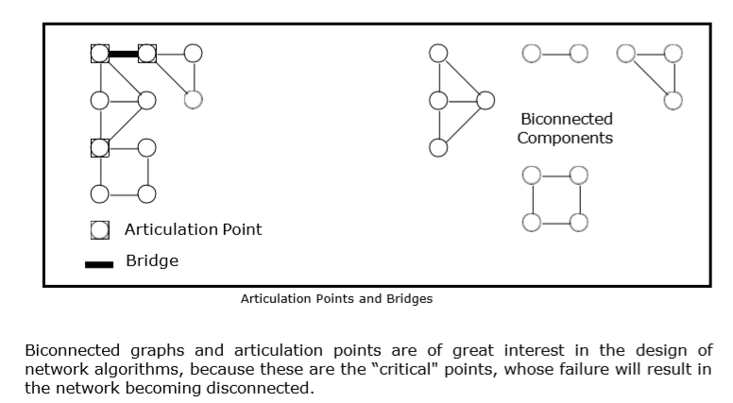
Articulation point

Slide 23
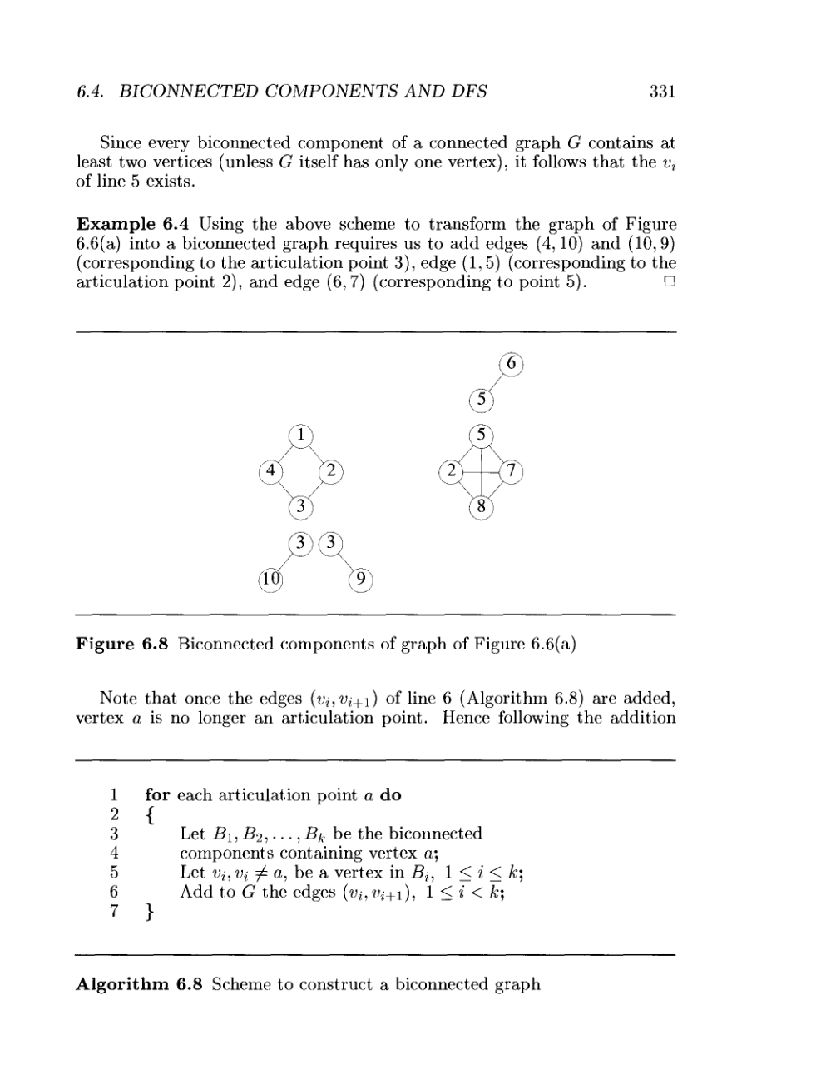
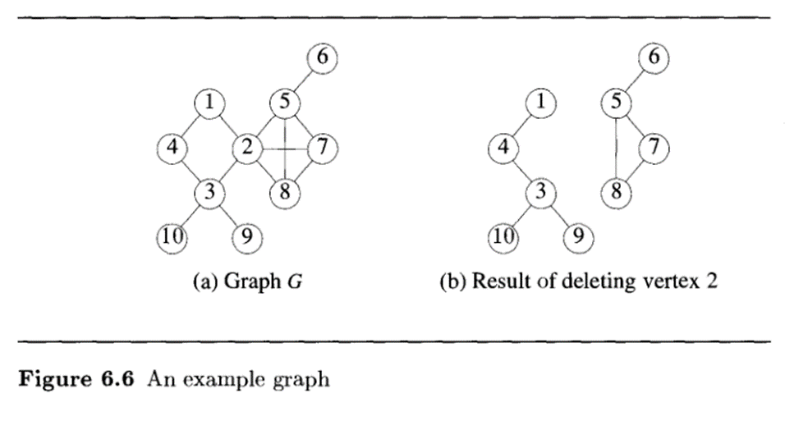
Bi-Connected Components

Slide 24
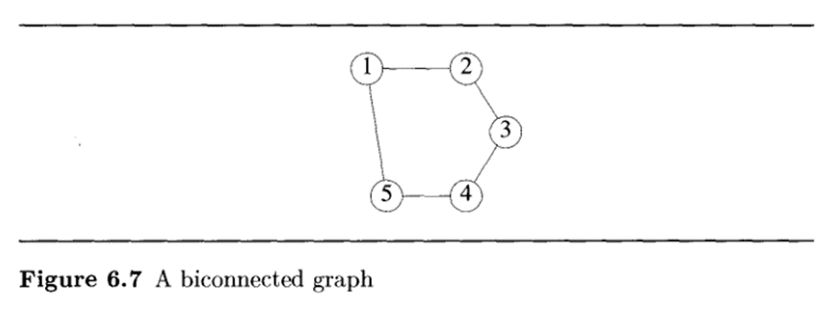
Algorithm for Bi-Connected graph

Slide 25
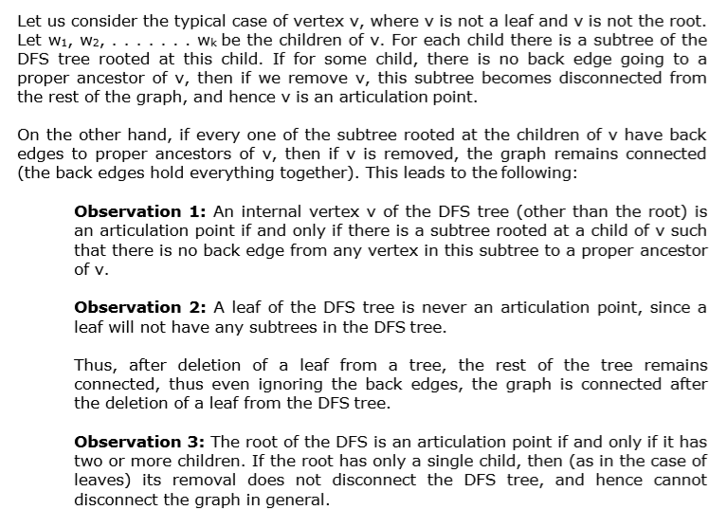
Finding Articulation point

Slide 26
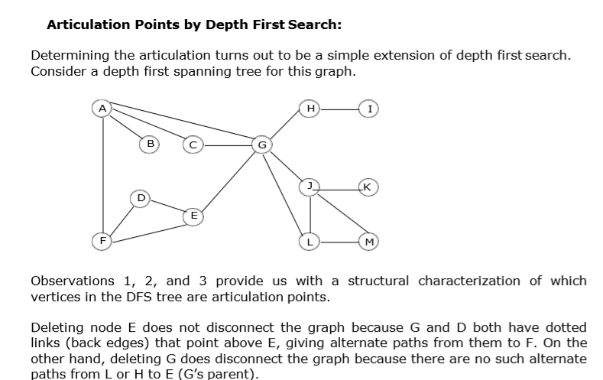
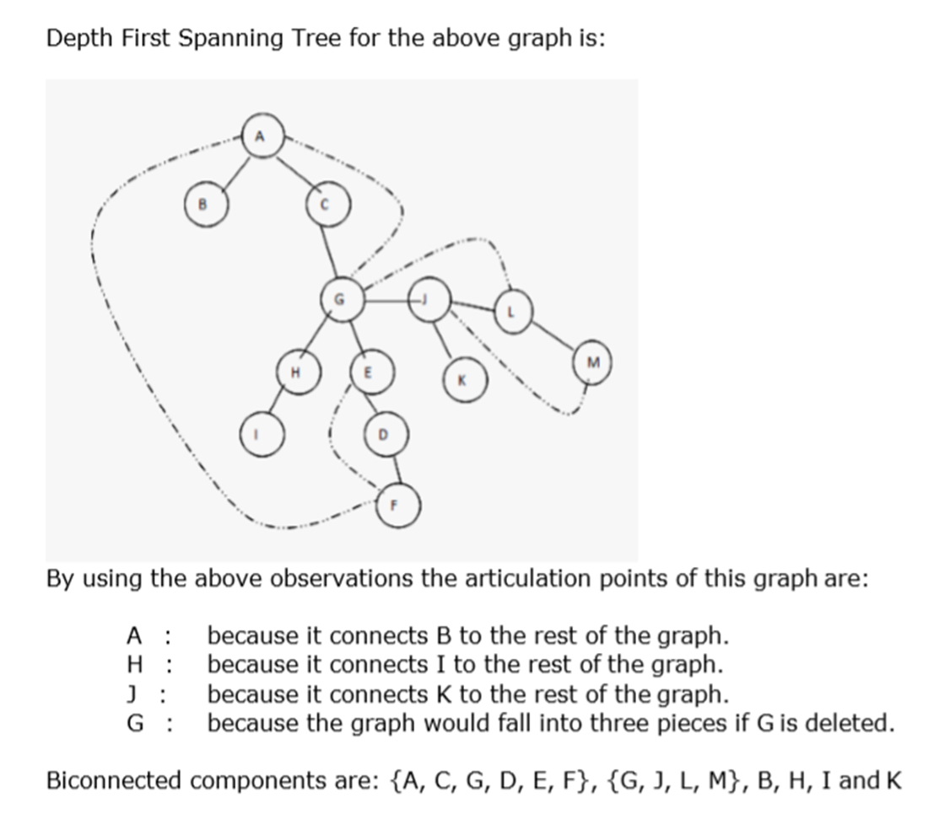
Finding Articulation point using DFS

Slide 27
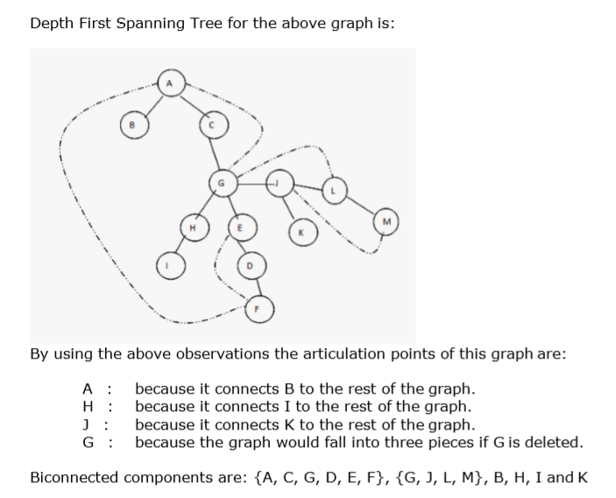
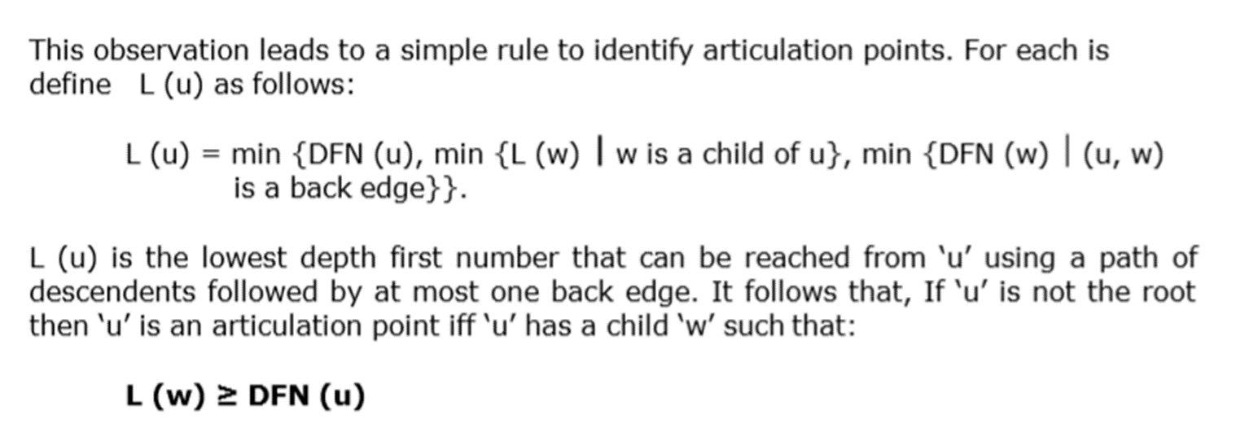
Finding Articulation point using DFS

Slide 28
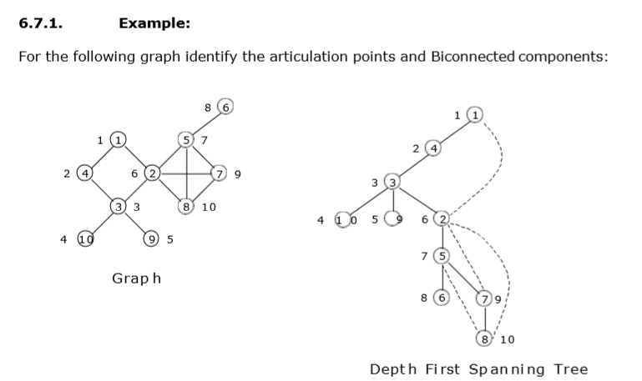
Example 1

Slide 29

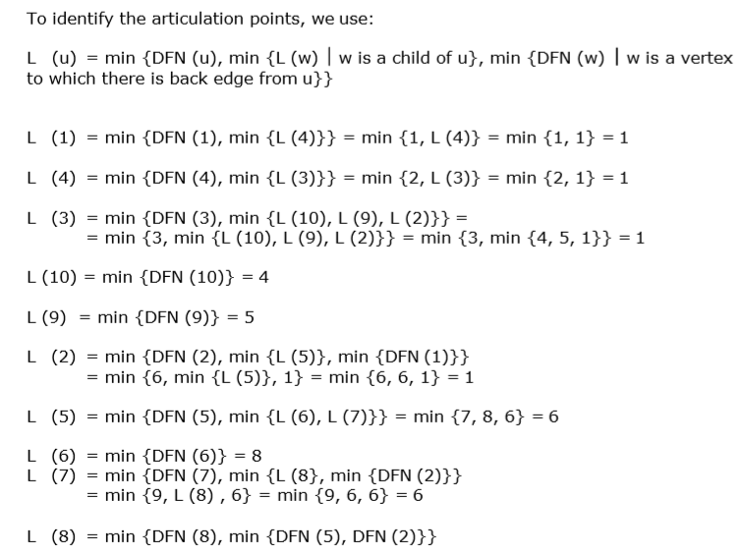
Example 1

Slide 30
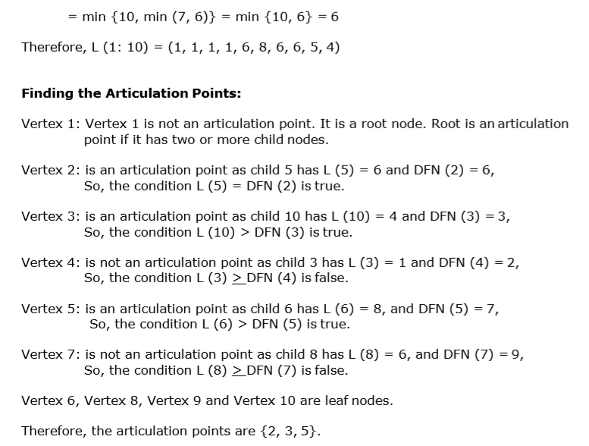

Example 1
Vertex | 1 | 2 | 3 | 4 | 5 | 6 | 7 | 8 | 9 | 10
DFN(u) | 1 | 6 | 3 | 2 | 7 | 8 | 9 | 10 | 5 | 4
L(u) | 1 | 1 | 1 | 1 | 6 | 8 | 6 | 6 | 5 | 4

Slide 31
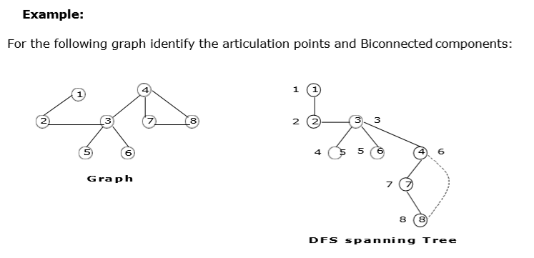
Example 2

Slide 32
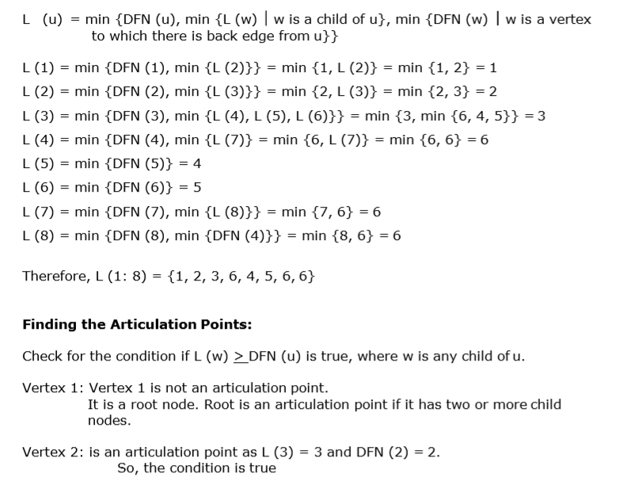
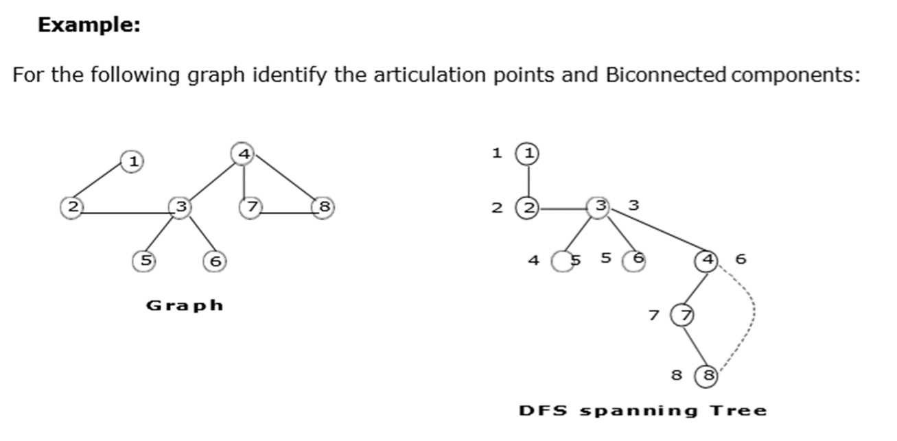
Example 2

Slide 33

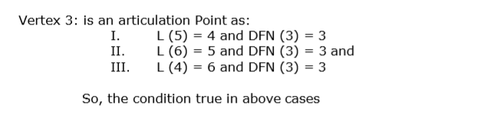
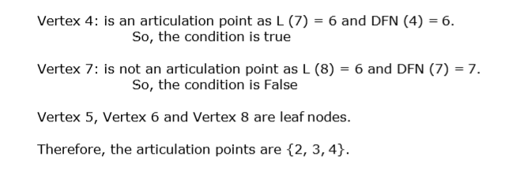
Example 2
Vertex | 1 | 2 | 3 | 4 | 5 | 6 | 7 | 8
DFN(u) | 1 | 2 | 3 | 6 | 4 | 5 | 7 | 8
L(u) | 1 | 2 | 3 | 6 | 4 | 5 | 6 | 6

Slide 34
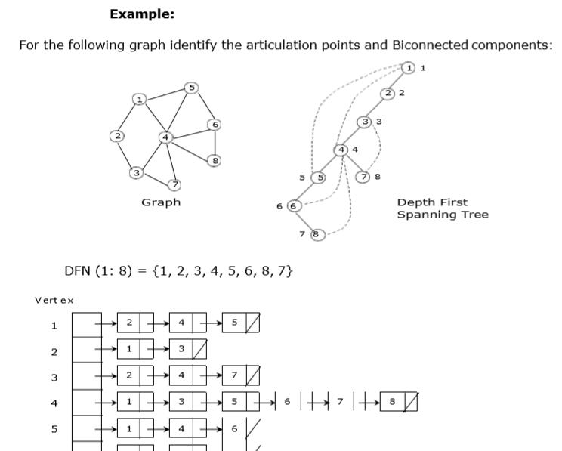
Example 3

Slide 35

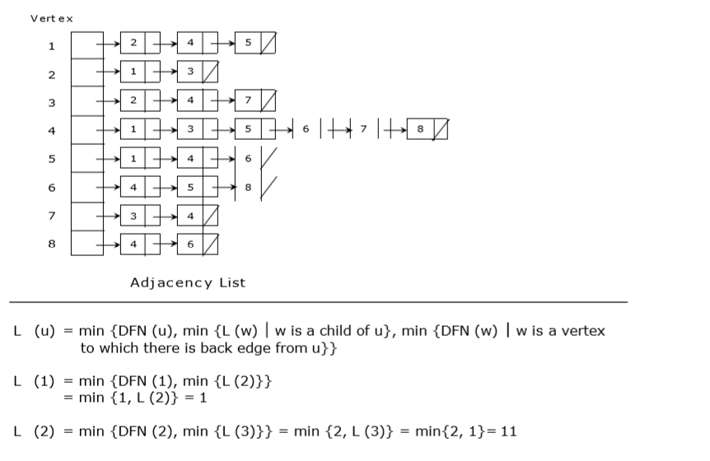
Example 3

Slide 36
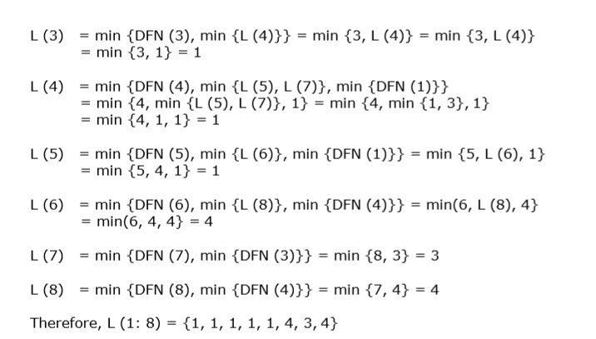
Example 3

Slide 37
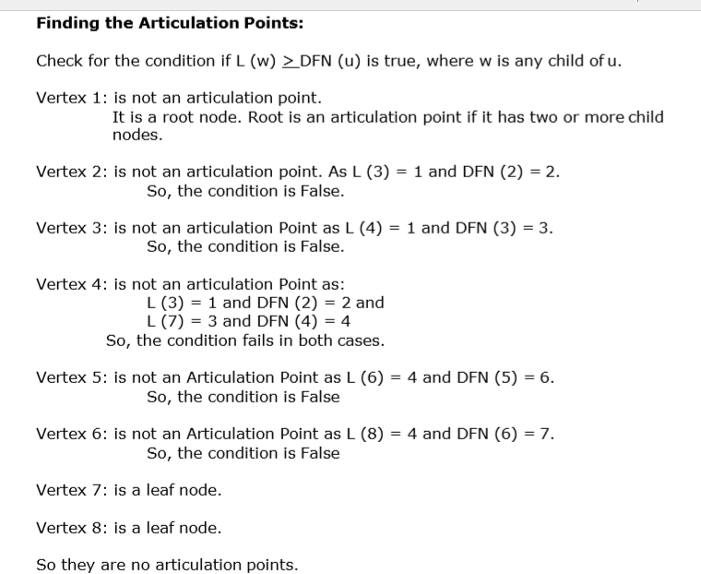

Example 3
Vertex | 1 | 2 | 3 | 4 | 5 | 6 | 7 | 8
DFN(u) | 1 | 2 | 3 | 4 | 5 | 6 | 8 | 7
L(u) | 1 | 1 | 1 | 1 | 1 | 4 | 3 | 4

Slide 38
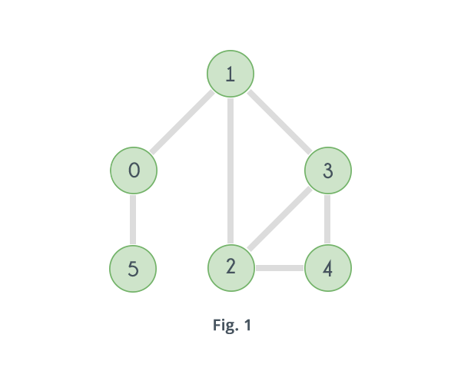
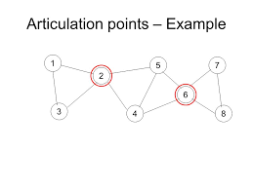
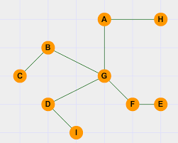
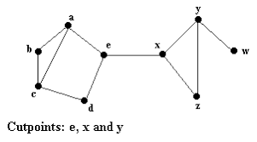
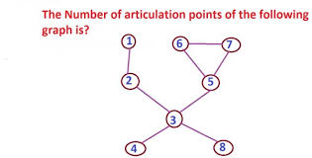
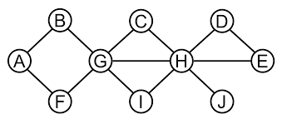
Exercise Problems on Articulation points using DFS

Slide 39
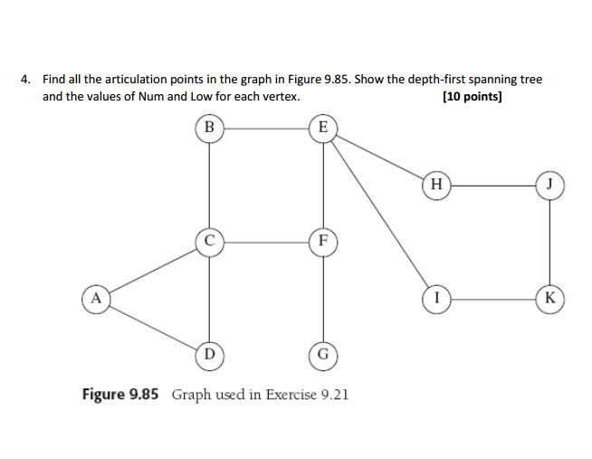



Problems

Slide 40


Algorithm for Articulation point
Time complexity of above method is O(V*(V+E)) for a graph represented using adjacency list.

Slide 41

Algorithm to determine Bi-Connected Components

Slide 42
Stable and Unstable Algorithms
Prepared by Dr. N. Subhash Chandra
Source: Web resources

Slide 43

Stable sorting
A sorting algorithm is said to be stable if the order of the same values in the output remains the same as in input array.
Stable Sorting algorithms: Insertion sort, Merge Sort, Bubble Sort
This is an example of stable sorting, element 12 appears twice at index 5 and at index 7. In the output array after sorting is done the order is maintained 12 which was at index 5 appears first and 12 which was at index 7 appears later.
Application of stability becomes more important when we have key value pairs where keys can be duplicated.

Slide 44

Unstable sorting
In an unstable sorting algorithm the ordering of the same values is not necessarily preserved after sorting.
Unstable sorting: Selection sort, Shell sort, Quicksort, Heapsort
Here you can see that the ordering for the same element 12 is not maintained after sorting.

Slide 45
Example: Stable vs Unstable Algorithm
Suppose you need to sort following key-value pairs in the increasing order of keys:
INPUT: (4,5), (3, 2) (4, 3) (5,4) (6,4)
Now, there is two possible solution for the two pairs where the key is the same i.e. (4,5) and (4,3) as shown below:
OUTPUT1: (3, 2), (4, 5), (4,3), (5,4), (6,4)
OUTPUT2: (3, 2), (4, 3), (4,5), (5,4), (6,4)
Stable sorting: Ex OUTPUT 1
because the original order of equal keys are maintained, you can see that (4, 5) comes before (4,3) in the sorted order, which was the original order i.e. in the given input, (4, 5) comes before (4,3) .
Unstable sorting: Ex OUTPUT 2:
because the order of objects with the same key is not maintained in the sorted order. You can see that in the second output, the (4,3) comes before (4,5) which was not the case in the original input.

Slide 46
When stability required?
Distinguishing Between Equal Elements:
All sorting algorithms use a key to determine the ordering of the elements in the collection, called the sort key.
If the sort key is the (entire) element itself, equal elements are indistinguishable, such as integers or strings.
On the other hand, equal elements are distinguishable if the sort key is made up of one or more, but not all attributes of the element, such as age in an Employee class.
Stable Sorting Is Important, Sometimes:
We don’t always need stable sorting. Stability is not a concern if:
equal elements are indistinguishable, or
all the elements in the collection are distinct
When equal elements are distinguishable, stability is imperative. For instance, if the collection already has some order, then sorting on another key must preserve that order.
For example, let’s say we are computing the word count of each distinct word in a text file. Now, we need to report the results in decreasing order of count, and further sorted alphabetically in case two words have the same count.

Slide 47
Example: Compute the word count:
 | Input:
 | how much wood would woodchuck chuck if woodchuck could chuck wood
 | Output:
 | how 1
 | much 1
 | wood 2
 | would 1
 | woodchuck 2
 | chuck 2
 | if 1
 | could 1
Second step – sort the whole list lexicographically, then by word count:
First pass, sorted lexicographically:
(chuck, 2)
(could, 1)
(how, 1)
(if, 1)
(much, 1)
(wood, 2)
(woodchuck, 2)
(would, 1)
Second pass, sorted by count using an unstable sort:
(wood, 2)
(chuck, 2)
(woodchuck, 2)
(could, 1)
(how, 1)
(if, 1)
(would, 1)
(much, 1)
Second pass, sorted by count using a stable sort:
(chuck, 2)
(wood, 2)
(woodchuck, 2)
(could, 1)
(how, 1)
(if, 1)
(much, 1)
(would, 1)
As we have used an unstable sort, the second pass does not maintain the lexicographical order.
That’s where the stable sort comes into the picture. Since we already had sorted the list lexicographically, using a stable sort to by word count does not change the order of equal elements anymore. As a result words with the same word count remain sorted lexicographically.

